Slide 1

SAS© to R for Medicine
2021 R/Medicine
Joseph Korszun, Data Science Consultant III, ProCogia
08/25/2021

Slide 2
Agenda
Introduction
Reading in Data
Data Wrangling
Data Exploration
Modeling Data

Slide 3
Code of Conduct
Screenshots
Recordings
Photographs
Harassment
https://r-medicine.org/code-of-conduct/
Notes:
One more serious thing we need to point out, since this is an interactive course - we want to provide a welcoming and supportive environment for all people, regardless of background or identity.
** So we have a strict no harassment policy: this includes abusive, offensive, or degrading language, in writing or voice
** for full CoC please take a look at the main website Attend > Code of Conduct https://r-medicine.org/code-of-conduct/
** Also, to respect the privacy of participants, we don’t allow screenshots, recordings, or photographs.
If we find that you violate the code of conduct you may be removed from the course.

Slide 4
Introduction

Slide 5
What is R?
R is an open-source programming language that was developed for doing statistical analysis
RStudio is a freely available Integrated Development Environment (IDE), a user-friendly interface for interacting with R
If programming in R is like driving a car, then you can think of R as the engine (under the hood) and Rstudio as the steering wheel, accelerator/brake pedals, dashboard.

Slide 6
Installation
cran.r-project.org: download R
Click download link appropriate for your OS
rstudio.com: download Rstudio
Download Rstudio → Choose R Studio Desktop

Slide 7
SAS© and R
SAS©
DATA steps for reading data into SAS©
PROCedures for analyses, sorting, etc.
Commercialized software
R
Data are stored as objects
Allows users to define new functions for additional functionality
Available for free

Slide 8
Why R?
Faster Computation Time
SAS© is processed at a row-by-row state vs R as columns in memory
File sharing and collaboration
RConnect, Git, Shiny Dashboards
Advanced Data Science Techniques
More well-known machine learning algorithms are available in R, but not yet in SAS©
Cost Effective
Single SAS© license is $8,700 for first year
Increased Talent Pool
Increased number of universities are teaching R over SAS©

Slide 9
SAS© vs R
SAS© | R
Data Steps | Expressions with functions
Procedures | Expressions with functions
Macros | Expressed in R functions
SAS© Functions | R Functions
SAS© ODS | R Markdown

Slide 10
R Packages
What is a package?
A package is shareable collection of code that is used to perform a desired function or specific task.
Who can make a package?
Anyone can make a package. You can make packages publicly available via CRAN (Comprehensive R Archive Network).

Slide 11
SAS©
Procedures
R Packages

Slide 12
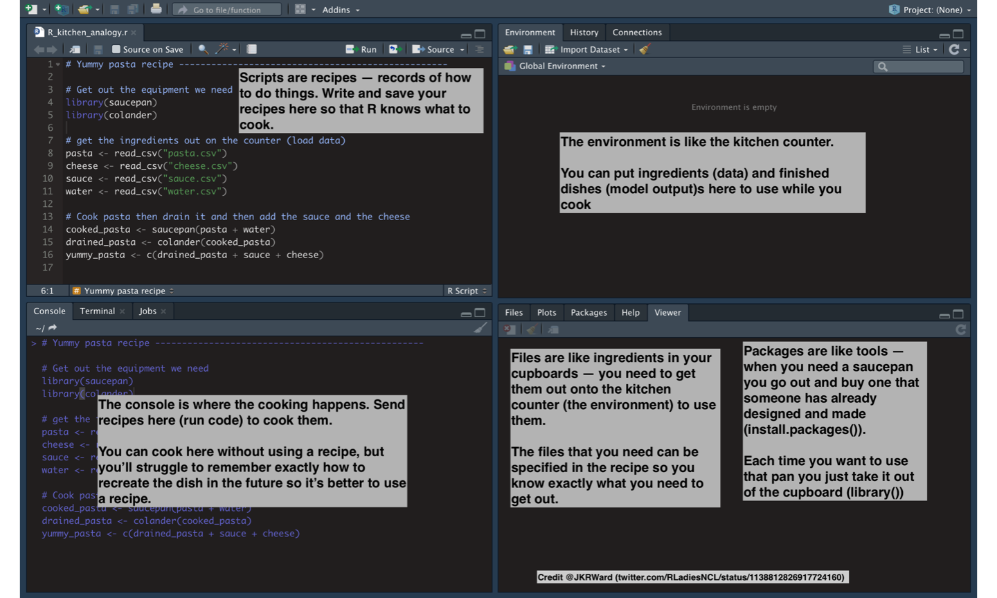
Basic Navigation
Notes:
Rstudio is like a kitchen

Slide 13
Getting Started
At a very basic level R is a glorified calculator.
#addition 2+2
## [1] 4
#Exponential 5^2
## [1] 25
#multiplication 5*4
## [1] 20
#division 10/2
## [1] 5
#modulus (returns remainder) 10%%3
## [1] 1
#Order of Operations (3+2)/5
## [1] 1

Slide 14
Assigning Variables
The <- symbol can be used to assign results to a variable for later use.
#do a few calculations, store the results in variables x and y x <- 32*4 y <-3 #create a third variable from x and y z <- x/y z
## [1] 42.66667

Slide 15
More Complicated Data Structures
Vectors
Can be strings, numeric (integers or real numbers)
Use c() to concatenate arguments together
# c() function concatenates arguments together pop <- c(234, 567, 10000)
area_sq_mi <- c(83.78,46.87,503)
city <- c("Seattle", "San Francisco", "L.A")

Slide 16
Vectors output
#outputs pop
## [1] 234 567 10000
area_sq_mi
## [1] 83.78 46.87 503.00
city
## [1] "Seattle" "San Francisco" "L.A"

Slide 17
More Complicated Data Structures
data.frame – collection of vectors of the same length, and the most useful structure for data analysis
tibble: Specialized version of a dataframe, designed with tidy analysis in mind
There are two main differences in the usage of a data frame vs a tibble: printing, and subsetting.
Tibbles have a refined print method that shows only the first 10 rows, and all the columns that fit on screen.
Tibbles are strict about subsetting. If you try to access a variable that does not exist, you’ll get an error

Slide 18
Dataframe Example
#dataframe example
city_info.d <- data.frame(pop, area_sq_mi, city)
city_info.d
## pop area_sq_mi city ## 1 234 83.78 Seattle ## 2 567 46.87 San Francisco ## 3 10000 503.00 L.A

Slide 19
Tibble Example
#tibble example
city_info <- tibble(pop, area_sq_mi, city)
city_info
## # A tibble: 3 x 3 ## pop area_sq_mi city ## <dbl> <dbl> <chr> ## 1 234 83.8 Seattle ## 2 567 46.9 San Francisco ## 3 10000 503 L.A

Slide 20
Programming Example

Slide 21
Reading in Data

Slide 22
Reading in Data from SAS©
SAS datasets can be read in using either the infile statement in the DATA step or using PROC IMPORT to import the dataset into SAS studio as a SAS7bdat file.
PROC IMPORT DATAFILE='/home/jkorszun340/ProCogia/covid.csv'
DBMS=CSV
OUT=covid;
GETNAMES=YES;
RUN;

Slide 23
Loading Data
Read data from a local file
Real data from a URL
Load data build-in to R packages

Slide 24
Looking at Data
To look at a dataset called “mydataset”, we have a few options to look at the data directly
mydata: simply running this in the console will show all data.
For tibbles, the output will be limited to rows and columns that fit on a screen.
View(mydata): look at data in familiar spreadsheet form (opens a new window)
head(mydata): look at first 6 rows of data (prints in console).
head(mydata, n=10): look at first 10 rows of data (prints in console).

Slide 25
Principles of Tidy Data
Each variable forms a column.
Each observation forms a row.
Each type of observational unit forms a table.

Slide 26
Why tidy data?
Consistency: code written with one tidy dataset/analysis in mind can easily be applied to another tidy dataset.
Most R functions work with vectors, so storing variables as vectors in columns makes sense.
The tidyverse packages (dplyr, ggplot2, etc) are designed to work with tidy data.

Slide 27
Tidyverse packages
Collection of packages designed to work with tidy data, including
dplyr for wrangling data
ggplot2 for data visualization
stringr for string manipulation
Can be installed with
install.packages(“tidyverse”) #only need to do once
In each new R session, tidyverse must be loaded using:
library(tidyverse) #must do every R session

Slide 28
Haven Package

Slide 29
Haven Package
Part of tidyverse
Reads SAS©, SPSS, and Stata files with different methods into R
Outputs are tibbles (don’t change variable names or types)
read_SAS() supports both SAS7bdat files and the accompanying SAS7bcat files that SAS© uses to record value labels.
write_SAS() is currently experimental and only works for limited datasets

Slide 30
Haven Example Import
#import data from SAS© covid.SAS <- read_SAS('covid.SAS7bdat') #check the input head(covid.SAS)
## # A tibble: 6 x 17 ## subject_id fake_first_name fake_last_name gender pan_day test_id clinic_name ## <dbl> <chr> <chr> <chr> <dbl> <chr> <chr> ## 1 1412 jhezane westerling female 4 covid inpatient wa~ ## 2 533 penny targaryen female 7 covid clinical lab ## 3 9134 grunt rivers male 7 covid clinical lab ## 4 8518 melisandre swyft female 8 covid clinical lab ## 5 8967 rolley karstark male 8 covid emergency de~ ## 6 11048 megga karstark female 8 covid oncology day~ ## # ... with 10 more variables: result <chr>, demo_group <chr>, age <dbl>, ## # drive_thru_ind <dbl>, ct_result <dbl>, orderset <dbl>, payor_group <chr>, ## # patient_class <chr>, col_rec_tat <dbl>, rec_ver_tat <dbl>

Slide 31
Programming Example

Slide 32
Break

Slide 33
Data Wrangling

Slide 34
Manipulating Data with dplyr
Data is rarely ready to analyze. Wrangling the data into proper shape is a critical task. Some key functions in dplyr are:
filter(): subset on rows
select(): subset on columns
arrange(): sort data by one or more columns
mutate(): create new columns from existing ones (keep old ones)
transmute(): create new columns from existing (only keep new)
spread(): transform data from “long” to “wide”
gather(): go from “wide” to “long”

Slide 35
Pipe Syntax
Say we want to restrict the WHO TB dataset to just China and Afghanistan, compute the incidence of TB (annual cases/ per 100,000 people), and finally sort the results by decreasing incidence. The following will work:
#filter, then mutate, then arrange tb_summary <- arrange( mutate( filter( table1, country %in% c("Afghanistan", "China") ), incidence=100000*cases/population), -incidence )
But this is very hard to read!

Slide 36
Pipe Syntax (and then)
The pipe symbol %>% is useful for chaining together such commands more intuitively:
#piping syntax table1 %>% #start with WHO data filter(country %in% c("Afghanistan", "China")) %>% #AND THEN filter mutate(incidence=100000*cases/population) %>% #AND THEN mutate arrange(-incidence) #AND THEN sort with arrange()
## # A tibble: 4 x 5 ## country year cases population incidence ## <chr> <int> <int> <int> <dbl> ## 1 China 2000 213766 1280428583 16.7 ## 2 China 1999 212258 1272915272 16.7 ## 3 Afghanistan 2000 2666 20595360 12.9 ## 4 Afghanistan 1999 745 19987071 3.73

Slide 37
SAS© PROC FORMAT
Formatting data in SAS© can be achieved through PROC FORMAT
Formats can be saved to the SAS© catalog for later use
Defining length of each field can be performed through the length statement with the DATA step
Logical iterations can be used to recode variables (if then statements)
PROC FORMAT;
value class
1=‘positive’
0=‘negative’
;
run;

Slide 38
fmtr package
Helps format data and provide basic functionality of SAS© formats. Part of the “SASsy” package.
The fdata() function to apply formatting to any data frame or tibble.
The fapply() function to apply formatting to any vector.
The formats() and fattr() functions to easily assign formatting attributes.
The value() and condition() functions to create a user-defined format.
The fcat() function to create a format catalog.
The flist() function to create a formatting list.

Slide 39
fmtr package fapply() example
#create sample vector to format sample.v <- c(6.3598, 7.568863, 1.1233, 5.66874) #apply format fapply(sample.v, "%1.1f")
## [1] "6.4" "7.6" "1.1" "5.7"

Slide 40
fmtr package fapply() example
#create sample vector to format sample.v <- c(6.3598, 7.568863, 1.1233, 5.66874) #assign format attribute attr(sample.v, "format") <- "%1.1f" #apply format fapply(sample.v)
## [1] "6.4" "7.6" "1.1" "5.7"

Slide 41
fmtr package fattr() example
#assigning multiple formatting attributes #create sample vector to format sample.v <- c(6.3598, 7.568863, 1.1233, 5.66874) #assign formatting attributes sample.v <- fattr(sample.v, format = "%1.1f", width = 5, justify = "right") #apply formatting attributes fapply(sample.v) #notice the padding to the left when there is additional spaces in width
## [1] " 6.4" " 7.6" " 1.1" " 5.7"

Slide 42
fmtr package lookup example
#Lookup Vectors #create sample vector sample.v2 <- c("A", "B", "C", "A", "B", "B") #create a lookup vector lookup.v2 <- c(A = "Group A", B = "Group B", C="Group C") #apply lookup to sample.v2 fapply(sample.v2, lookup.v2)
## [1] "Group A" "Group B" "Group C" "Group A" "Group B" "Group B"

Slide 43
fcat() from fmtr
Saving formats in catalogs can help save time and aid reproducible code
#Create formatting catalog date.format <- fcat(num_fmt="%.1f",date_fmt = "%d%b%Y") #write catalog to working directory write.fcat(date.format, dir_path = '~/OneDrive - ProCogia/Desktop/SAS© to R/Presentations/SAS© to R for Medicine/R Programs/')
## [1] "~/OneDrive - ProCogia/Desktop/SAS© to R/Presentations/SAS© to R for Medicine/R Programs//date.format.fcat"
#read in catalog format read.fcat("date.format.fcat")
## # A format catalog: 2 formats ## - $num_fmt: type S, "%.1f" ## - $date_fmt: type S, "%d%b%Y"
#example date Sys.Date()
## [1] "2021-08-22"
#formatted date fapply(Sys.Date(), date.format$date_fmt)
## [1] "22Aug2021"

Slide 44
Programming Example

Slide 45
Data Exploration

Slide 46
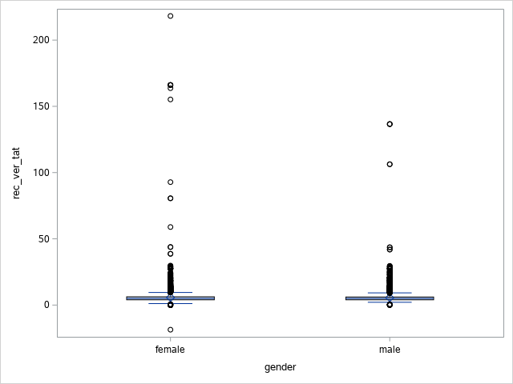
PROC SGPLOT
PROC SGPLOT can be used for a variety of visual plots from histograms to residual plots
PROC SGPLOT data= covid;
vbox rec_ver_tat/category=gender;
run;

Slide 47
Visualizing Data
Grammar of Graphics:
A layered framework to build visualizations
Implemented in R with the ggplot2 package
Layers of a visualization are built up one by one
Starting with dataset, things like axes, labels, points, and groupings are added one at a time.
This is non-intuitive at first, but allows for a high level of control over final plot

Slide 48
Visualizing Data Example
#load star wars dataset data("starwars") #use filter to subset dataset to just humans and droids human_droid <- starwars %>% filter(species %in% c("Human", "Droid")) %>% drop_na(height, mass) #drop rows with missing height or mass #first specify dataset and x/y variables #tell ggplot to make a scatter plot using geom_point() #add in titles and axis labels starwars_plot <- ggplot(data=human_droid, aes(x=height, y=mass))+ geom_point(aes(color=species)) + ggtitle("Mass vs Height for humans and droids") + xlab("Height (cm)") + ylab("Mass (kg)")

Slide 49
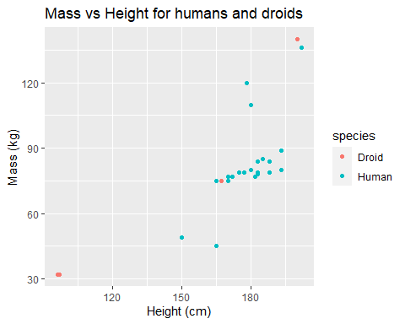
Visualizing Data Example
#output starwars_plot

Slide 50
PROC FREQ
PROC FREQ can be used for various functions. It is commonly used to summarize categorical variables
Provides summary tables with counts/frequencies and cumulative frequencies of a categorical variable
proc freq data=covid order=data;
table gender*payor_group;
run;

Slide 51
PROC FREQ Output
Frequency Percent Row Pct Col Pct
Table of gender by payor_group
gender | payor_group
 | government | commercial | NA | unassigned | medical assi | self pay | other | charity care | Total
female | 1864 12.01 23.80 51.15 | 1863 12.00 23.79 50.00 | 3556 22.91 45.40 50.18 | 367 2.36 4.69 50.07 | 46 0.30 0.59 54.76 | 114 0.73 1.46 52.78 | 13 0.08 0.17 68.42 | 9 0.06 0.11 60.00 | 7832 50.45
male | 1780 11.47 23.14 48.85 | 1863 12.00 24.22 50.00 | 3531 22.75 45.90 49.82 | 366 2.36 4.76 49.93 | 38 0.24 0.49 45.24 | 102 0.66 1.33 47.22 | 6 0.04 0.08 31.58 | 6 0.04 0.08 40.00 | 7692 49.55
Total | 3644 23.47 | 3726 24.00 | 7087 45.65 | 733 4.72 | 84 0.54 | 216 1.39 | 19 0.12 | 15 0.10 | 15524 100.00

Slide 52
Arsenal Package

Slide 53
Arsenal Package
Provides 6 main functions that are like a local SAS© macro or procedure of similar functionality:
tableby(): function used to summarize set of independent variables by one or more categorical values
paired(): summarize a set of independent variables across two time points
modelsum(): function to fit and summarize models for each independent variable with one or more response values
freqlist(): used to approximate the output from SAS’s PROC FREQ
comparedf(): compares two dataframes and reports differences between then. Similar to SAS’s PROC COMPARE.
write2*(): write 2 family functions for HTML, Word, pdf for output tables

Slide 54
Arsenal Package freqlist() example
#add library reference library(arsenal) #read in covid dataset covid <- read.csv("~/OneDrive - ProCogia/Desktop/SAS© to R/Presentations/SAS© to R for Medicine/R Programs/covid.csv", header = TRUE) #check dataset output head(covid)
## subject_id fake_first_name fake_last_name gender pan_day test_id ## 1 1412 jhezane westerling female 4 covid ## 2 533 penny targaryen female 7 covid ## 3 9134 grunt rivers male 7 covid ## 4 8518 melisandre swyft female 8 covid ## 5 8967 rolley karstark male 8 covid ## 6 11048 megga karstark female 8 covid

Slide 55
Arsenal Package freqlist() example
#freqlist() function covid.t <- table(covid[c("result", "demo_group","gender")]) output_fl <- freqlist(covid.t, na.options = "include") #print output summary summary(output_fl)
## |result |demo_group |gender | Freq| Cumulative Freq| Percent| Cumulative Percent| ## |:--------|:------------|:------|----:|---------------:|-------:|------------------:| ## |invalid |client |female | 17| 17| 0.11| 0.11| ## | | |male | 8| 25| 0.05| 0.16| ## | |misc adult |female | 29| 54| 0.19| 0.35| ## | | |male | 36| 90| 0.23| 0.58| ## | |other adult |female | 4| 94| 0.03| 0.61| ## | | |male | 3| 97| 0.02| 0.62| ## | |patient |female | 96| 193| 0.62| 1.24| ## | | |male | 108| 301| 0.70| 1.94| ## |negative |client |female | 263| 564| 1.69| 3.63| ## | | |male | 235| 799| 1.51| 5.15| ## | |misc adult |female | 1069| 1868| 6.89| 12.03| ## | | |male | 1075| 2943| 6.92| 18.96| ## | |other adult |female | 118| 3061| 0.76| 19.72| ## | | |male | 90| 3151| 0.58| 20.30| ## | |patient |female | 5787| 8938| 37.28| 57.58| ## | | |male | 5720| 14658| 36.85| 94.42| ## | |unidentified |male | 1| 14659| 0.01| 94.43| ## |positive |client |female | 34| 14693| 0.22| 94.65| ## | | |male | 47| 14740| 0.30| 94.95| ## | |misc adult |female | 116| 14856| 0.75| 95.70| ## | | |male | 116| 14972| 0.75| 96.44| ## | |other adult |female | 4| 14976| 0.03| 96.47| ## | | |male | 4| 14980| 0.03| 96.50| ## | |patient |female | 295| 15275| 1.90| 98.40| ## | | |male | 249| 15524| 1.60| 100.00|

Slide 56
Programming Example

Slide 57
Modeling Data

Slide 58
Arsenal Package tableby()
Let's look at the covid dataset again. If we wanted to test explanatory variable’s (patient_class and gender) levels to the response variable (result) the following would work to:
#tableby() function output <- tableby(result ~ patient_class + gender, covid) #print output summary summary(output, text=TRUE)

Slide 59
Arsenal Package tableby() Output
## | | invalid (N=301) | negative (N=14358) | positive (N=865) | Total (N=15524) | p value| ## |:--------------------------|:---------------:|:------------------:|:----------------:|:---------------:|-------:| ## |patient_class | | | | | < 0.001| ## |- N-Miss | 106 | 6492 | 479 | 7077 | | ## |- admit after surgery-ip | 0 (0.0%) | 4 (0.1%) | 0 (0.0%) | 4 (0.0%) | | ## |- admit after surgery-obs | 0 (0.0%) | 1 (0.0%) | 0 (0.0%) | 1 (0.0%) | | ## |- day surgery | 0 (0.0%) | 37 (0.5%) | 2 (0.5%) | 39 (0.5%) | | ## |- emergency | 9 (4.6%) | 1242 (15.8%) | 127 (32.9%) | 1378 (16.3%) | | ## |- inpatient | 89 (45.6%) | 3246 (41.3%) | 103 (26.7%) | 3438 (40.7%) | | ## |- not applicable | 14 (7.2%) | 1031 (13.1%) | 51 (13.2%) | 1096 (13.0%) | | ## |- observation | 28 (14.4%) | 669 (8.5%) | 26 (6.7%) | 723 (8.6%) | | ## |- outpatient | 25 (12.8%) | 882 (11.2%) | 66 (17.1%) | 973 (11.5%) | | ## |- recurring outpatient | 30 (15.4%) | 754 (9.6%) | 11 (2.8%) | 795 (9.4%) | | ## |gender | | | | | 0.548| ## |- female | 146 (48.5%) | 7237 (50.4%) | 449 (51.9%) | 7832 (50.5%) | | ## |- male | 155 (51.5%) | 7121 (49.6%) | 416 (48.1%) | 7692 (49.5%) | |
patient_class is significant

Slide 60
Arsenal Package write2*()
write2*(): write 2 family functions for HTML, Word, pdf for output tables
Lets see an example of the write2pdf() function for the table we created
write2pdf(output, "~/OneDrive - ProCogia/Desktop/SAS© to R/Presentations/SAS© to R for Medicine/R Programs/output_tableby()")

Slide 61
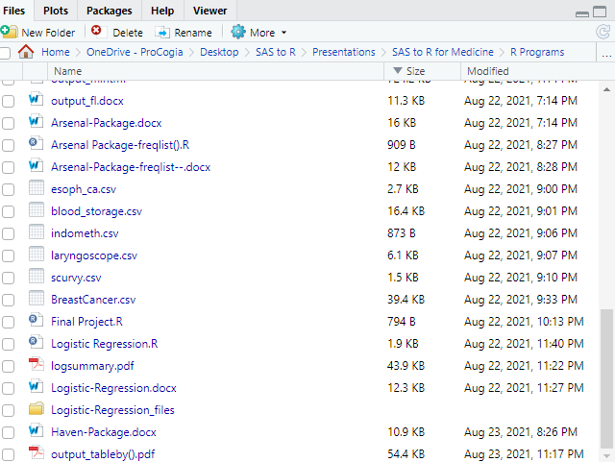
Arsenal Package write2*()
We can see “output_tableby() has shown up in our file directory

Slide 62
Programming Example

Slide 63
Logistic Regression
Let's look at the BreastCancer dataset. We want to perform a binary fit to the response variable “Class”.
#check first 5 observations head(breastCancer)
## Id Cl.thickness Cell.size Cell.shape Marg.adhesion Epith.c.size ## 1 1000025 5 1 1 1 2 ## 2 1002945 5 4 4 5 7 ## 3 1015425 3 1 1 1 2 ## 4 1016277 6 8 8 1 3 ## 5 1017023 4 1 1 3 2 ## 6 1017122 8 10 10 8 7 ## Bare.nuclei Bl.cromatin Normal.nucleoli Mitoses Class ## 1 1 3 1 1 benign ## 2 10 3 2 1 benign ## 3 2 3 1 1 benign ## 4 4 3 7 1 benign ## 5 1 3 1 1 benign ## 6 10 9 7 1 malignant

Slide 64
Logistic Regression Modeling
#check summary of the data summary(breastCancer)
## Id Cl.thickness Cell.size Cell.shape ## Min. : 61634 Min. : 1.000 Min. : 1.000 Min. : 1.000 ## 1st Qu.: 870688 1st Qu.: 2.000 1st Qu.: 1.000 1st Qu.: 1.000 ## Median : 1171710 Median : 4.000 Median : 1.000 Median : 1.000 ## Mean : 1071704 Mean : 4.418 Mean : 3.134 Mean : 3.207 ## 3rd Qu.: 1238298 3rd Qu.: 6.000 3rd Qu.: 5.000 3rd Qu.: 5.000 ## Max. :13454352 Max. :10.000 Max. :10.000 Max. :10.000 ## ## Marg.adhesion Epith.c.size Bare.nuclei Bl.cromatin ## Min. : 1.000 Min. : 1.000 Min. : 1.000 Min. : 1.000 ## 1st Qu.: 1.000 1st Qu.: 2.000 1st Qu.: 1.000 1st Qu.: 2.000 ## Median : 1.000 Median : 2.000 Median : 1.000 Median : 3.000 ## Mean : 2.807 Mean : 3.216 Mean : 3.545 Mean : 3.438 ## 3rd Qu.: 4.000 3rd Qu.: 4.000 3rd Qu.: 6.000 3rd Qu.: 5.000 ## Max. :10.000 Max. :10.000 Max. :10.000 Max. :10.000 ## NA's :16 ## Normal.nucleoli Mitoses Class ## Min. : 1.000 Min. : 1.000 Length:699 ## 1st Qu.: 1.000 1st Qu.: 1.000 Class :character ## Median : 1.000 Median : 1.000 Mode :character ## Mean : 2.867 Mean : 1.589 ## 3rd Qu.: 4.000 3rd Qu.: 1.000 ## Max. :10.000 Max. :10.000

Slide 65
Logistic Regression Modeling
#we can model all the data using the family=binomial in the glm function
glm.fit <- glm(Class ~ ., data = breastCancer, family = binomial)
#check the summary of the binary model summary(glm.fit)

Slide 66
Logistic Regression Modeling Output
## Deviance Residuals: ## Min 1Q Median 3Q Max ## -3.4841 -0.1153 -0.0619 0.0222 2.4698 ## ## Coefficients: ## Estimate Std. Error z value Pr(>|z|) ## (Intercept) -10.10394 1.17488 -8.600 < 2e-16 *** ## Cl.thickness 0.53501 0.14202 3.767 0.000165 *** ## Cell.size -0.00628 0.20908 -0.030 0.976039 ## Cell.shape 0.32271 0.23060 1.399 0.161688 ## Marg.adhesion 0.33064 0.12345 2.678 0.007400 ** ## Epith.c.size 0.09663 0.15659 0.617 0.537159 ## Bare.nuclei 0.38303 0.09384 4.082 4.47e-05 *** ## Bl.cromatin 0.44719 0.17138 2.609 0.009073 ** ## Normal.nucleoli 0.21303 0.11287 1.887 0.059115 . ## Mitoses 0.53484 0.32877 1.627 0.103788 ## --- ## Signif. codes: 0 '***' 0.001 '**' 0.01 '*' 0.05 '.' 0.1 ' ' 1 ## ## (Dispersion parameter for binomial family taken to be 1) ## ## Null deviance: 884.35 on 682 degrees of freedom ## Residual deviance: 102.89 on 673 degrees of freedom ## (16 observations deleted due to missingness) ## AIC: 122.89 ## ## Number of Fisher Scoring iterations: 8

Slide 67
Logistic Regression Modeling Output
#lets check the coefficients coef(glm.fit)
## (Intercept) Cl.thickness Cell.size Cell.shape Marg.adhesion ## -10.103942243 0.535014068 -0.006279717 0.322706496 0.330636915 ## Epith.c.size Bare.nuclei Bl.cromatin Normal.nucleoli Mitoses ## 0.096635417 0.383024572 0.447187920 0.213030682 0.534835631

Slide 68
Agenda
On Home tab
New slide > duplicate selected slide
This will make sure you have the footer
Then you can adjust the layout

Slide 69
Do’s & Don’ts
There is a master slide setting in place, please do not change the master slide, the logo is tied to it
The font and sizing are tied to master as well
As this is a template when you create a new deck from it you can then add/remove slides, insert you visuals and delete the guide text (as it copies over too)

Slide 70
Logo Colour Palette
Green
RGB: 149, 193, 0
CMYK: 48, 4, 100
HEX: #95c100
Blue
RGB: 31, 184, 204
CMYK: 71, 4, 19, 0
HEX: #1fb8cc
Dark Gray
RGB: 51, 51, 51
CMYK: 69, 63, 62, 58
HEX: #333333

